Slide 1
Provider Profiling Using GNN

Slide 2
1
Topic#1
2 minutes
Agenda
2
Topic#2
5 minutes
3
Topic#3
5 minutes
4
Topic#4
8 minutes
5
Topic#5
10 minutes

Slide 3
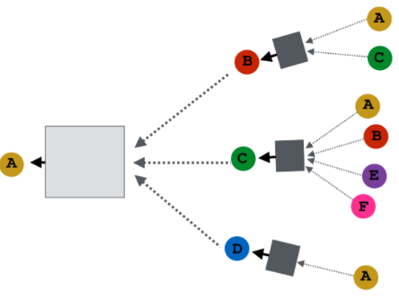
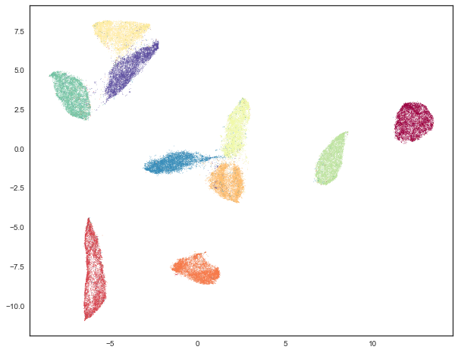
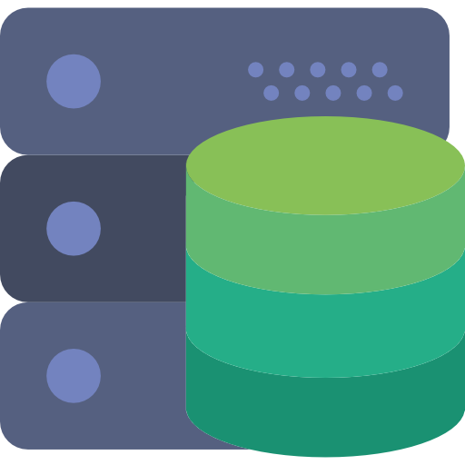


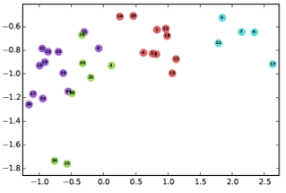
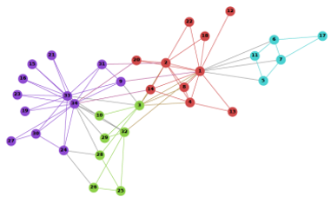


Graph Neural Network Using Referral Database
Py-tigergraph
Provider Profiles
Claims
Denials
Admission
Pytorch- Geometric
Patient
GMM –
Sklearn
Functional Analysis
Providers
TigerGraph DB
Conda Environment (Python 3.7.9)

Slide 4
Graph Neural Network Using Referral Database
Py-tigergraph
Condition Classification
Symptom
Medication
Condition
Pytorch- Geometric
Patient
Pytorch
Functional Analysis
Observation
TigerGraph DB
Conda Environment (Python 3.7.9)

Slide 5
Q & A
Thanks

